Slide 1


CVCS Escapement Modeling
The Mathematics of the CVCS Escapement Model
Presented by:
Arthur Barros, California Department of Fish and Wildlife
Arthur.Barros@wildlife.ca.gov

Slide 2
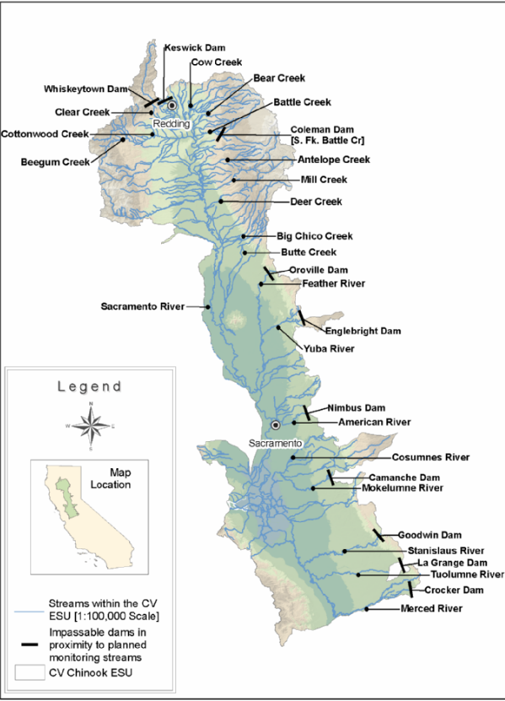
CVCS Escapement Monitoring Plan
Bergman et al. 2013.
“a science- based collaborative approach to improve monitoring of adult Chinook salmon returning from the ocean to spawn in CV streams (escapement) and harvested in freshwater”
Bergman, J. M., Nielson, R. M., & Low, A. (2013). CENTRAL VALLEY CHINOOK SALMON IN-RIVER ESCAPEMENT MONITORING PLAN. Paper Knowledge . Toward a Media History of Documents, 12–26.

Slide 3
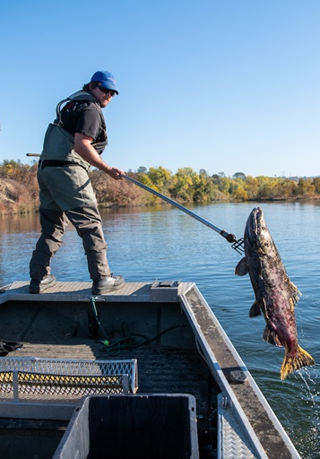
CVCS Carcass Surveys
Carcasses are captured during survey periods, usually weekly.
Carcasses are marked with disctags and deposited back into the system for future recapture.
Carcasses that are decayed to a point where identification or measurement is difficult are “chopped”.
Photo attribution: DWR 2020 https://water.ca.gov/News/Blog/2020/December/Carcass-Survey-Helps-DWR-Learn-About-Health-of-Salmon-Species

Slide 4
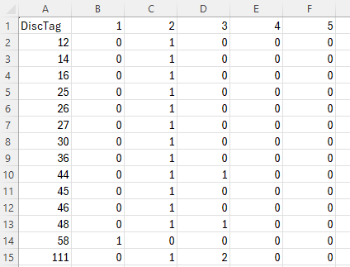
The Data: capture histories
Records of capture and recapture for a given carcass.
0 = indicates carcass was not capture during that period.
1 = indicates carcass was captured and returned.
2 = carcass was captured and “chopped”.
demo_CH.csv

Slide 5
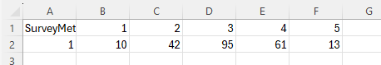
The Data: chops
Records of number of carcasses removed from system upon first capture.
Done when carcass is deteriorated beyond identification or measurement, and won’t last long enough for further recaptures.
demo_Chops.csv

Slide 6
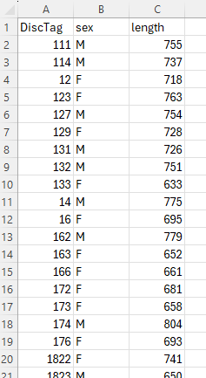
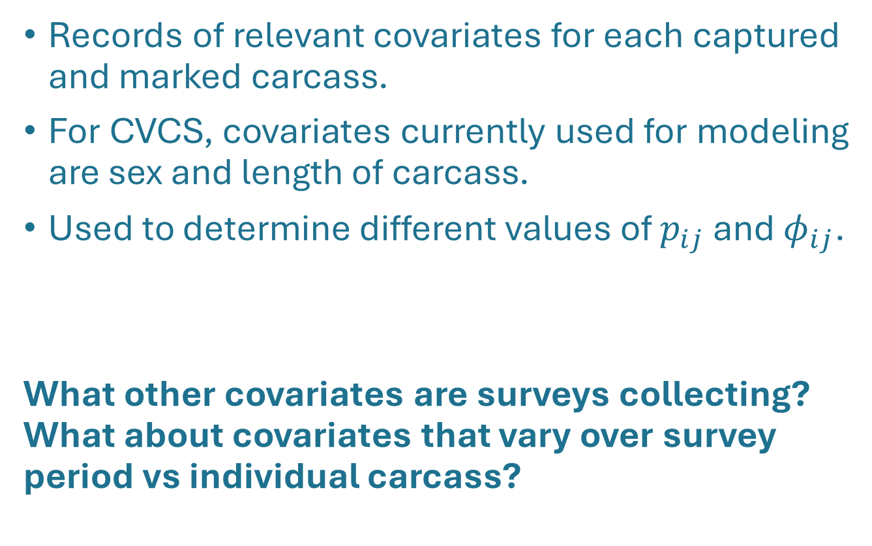
The Data: covariates
Records of relevant covariates for each captured and marked carcass.
For CVCS, covariates currently used for modeling are sex and length of carcass.
Used to determine different values of $p_{ij}$ and ${\text{φ}}_{ij}$.
What other covariates are surveys collecting? What about covariates that vary over survey period vs individual carcass?
demo_Covariates.csv

Slide 7
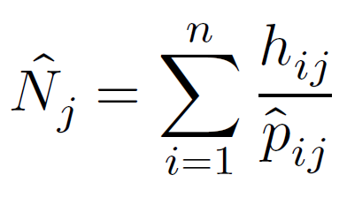
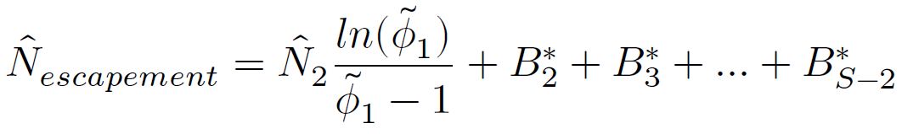
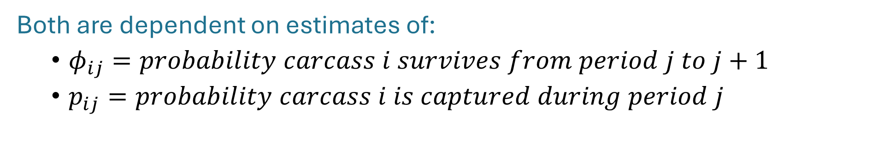
Estimating $p_{ij}$ and ${\text{φ}}_{ij}$
Recall the Horvitz-Thompson estimator:
and the superpopulation modification:
Both are dependent on estimates of:
${\text{φ}}_{ij}=probability carcass i survives from period j to j+1$
$p_{ij}=probability carcass i is captured during period j$

Slide 8
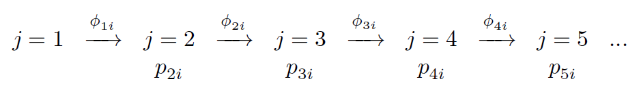
Estimating $p_{ij}$ and ${\text{φ}}_{ij}$
We can use $p_{ij}$ and ${\text{φ}}_{ij}$ to represent the capture history of a given carcass i during period j as:

Slide 9
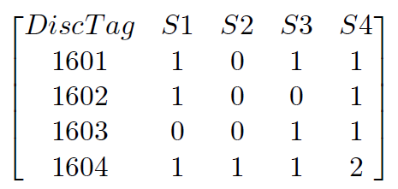
Estimating $p_{ij}$ and ${\text{φ}}_{ij}$
Consider this simplified set of capture histories:
We can represent the likelihood of observing the capture history of fish 1601 as:

Slide 10
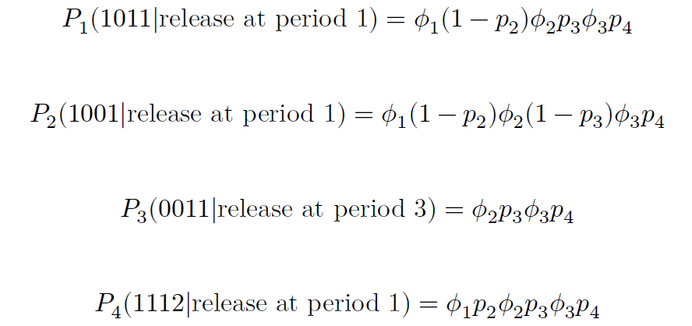
Estimating $p_{ij}$ and ${\text{φ}}_{ij}$
We can represent the likelihood of observing our four capture histories as:
Notes:
In the above note the 2 at the end of the last capture history representing a chopped event. Chopped carcasses will be dealt with later. Also note that for 𝑃3 the likelihood conditions on the initial observation and excludes estimates of 𝜙 or 𝑝 before that period.

Slide 11
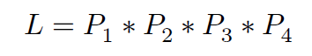
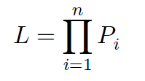
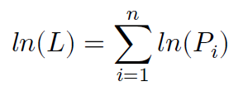
Estimating $p_{ij}$ and ${\text{φ}}_{ij}$
We can use the prior equations to represent the total likelihood of observing all capture histories as:
Or as the product of all the n capture history probabilities as:
Which can be made easier for computation by log-transforming our likelihoods:
The above is known as the “log-likelihood” of the probability.

Slide 12
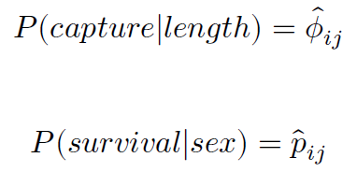
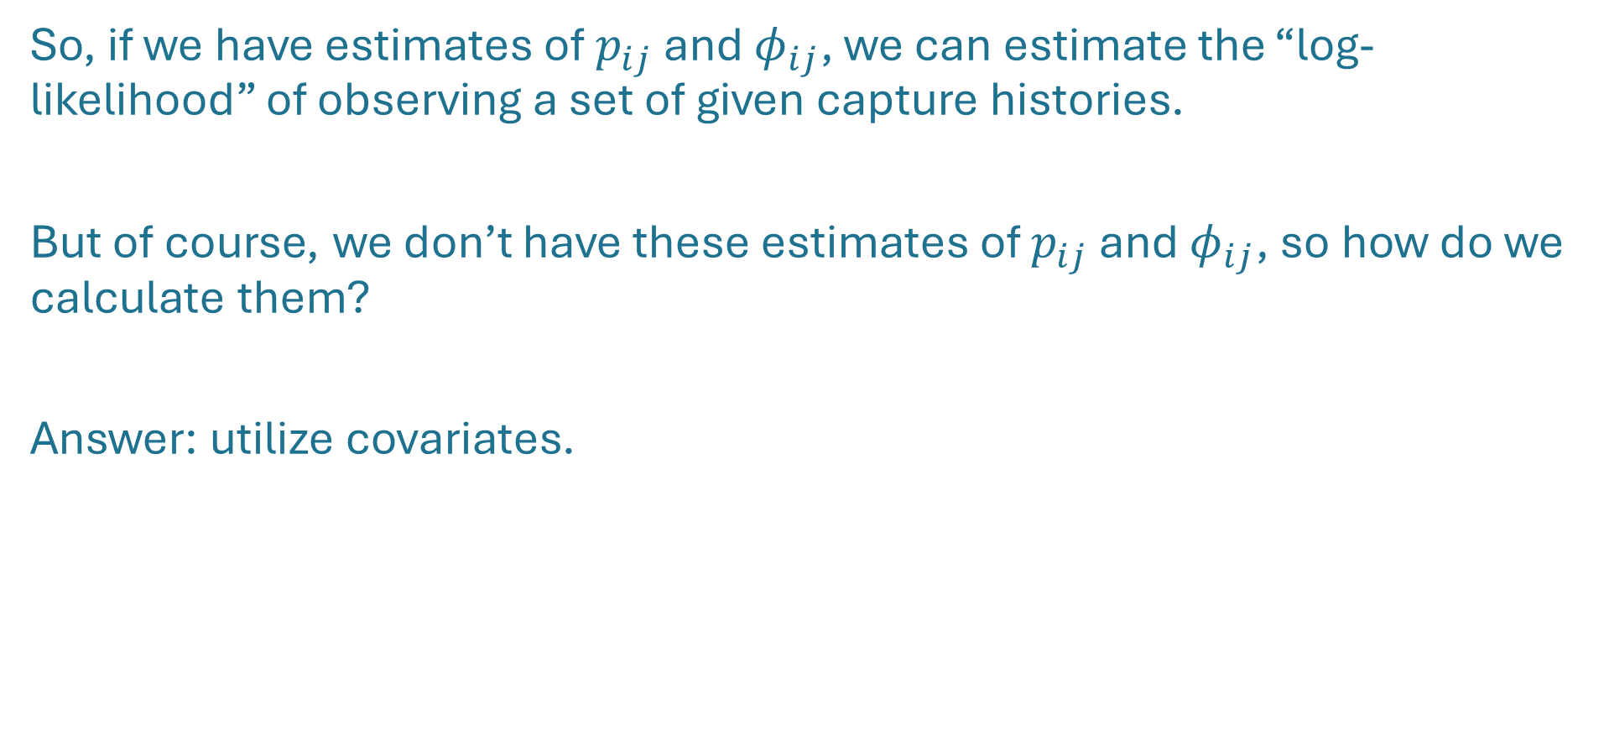
Estimating $p_{ij}$ and ${\text{φ}}_{ij}$
So, if we have estimates of $p_{ij}$ and ${\text{φ}}_{ij}$, we can estimate the “log-likelihood” of observing a set of given capture histories.
But of course, we don’t have these estimates of $p_{ij}$ and ${\text{φ}}_{ij}$, so how do we calculate them?
Answer: utilize covariates.

Slide 13
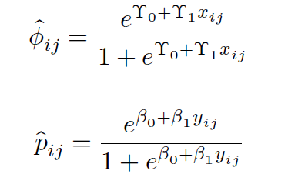
Logistic regression of $p_{ij}$ and ${\text{φ}}_{ij}$
The probability of capture or survival given a specific covariate can best be represented with logistic regression models:

Slide 14
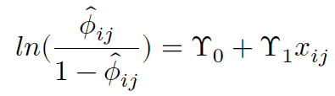
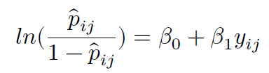
Logistic regression of $p_{ij}$ and ${\text{φ}}_{ij}$
The prior logistic models can be transformed to “logit” (log odds) functions to model the probabilities as linear functions of our covariates:

Slide 15
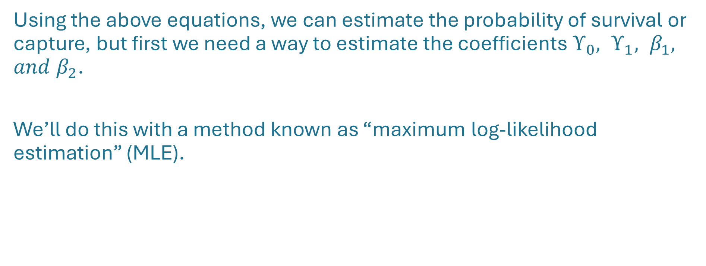
Maximum log-likelihood estimation (MLE)
Using the above equations, we can estimate the probability of survival or capture, but first we need a way to estimate the coefficients $ϒ_{0}, ϒ_{1}, β_{1}, and β_{2}$.
We’ll do this with a method known as “maximum log-likelihood estimation” (MLE).

Slide 16
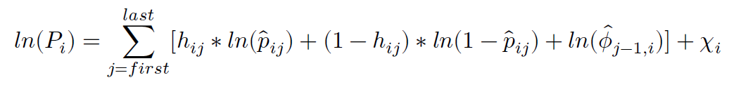
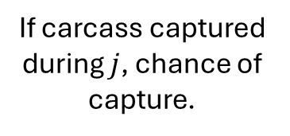

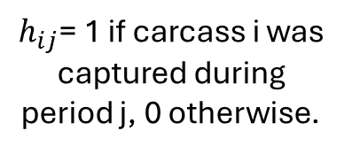
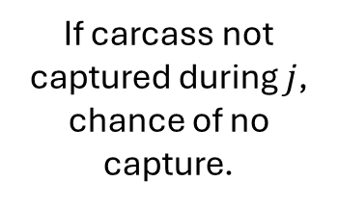
Maximum log-likelihood estimation (MLE)
Recall the above equation, where "$\ln\left(P_{i}\right)" is the$log-likelihood of observing the capture history for a given carcass.
If carcass captured during $j$, chance of capture.
If carcass not captured during $j$, chance of no capture.
Chance carcass survives from j-1 to j.
$$chi$$
$h_{ij}$= 1 if carcass i was captured during period j, 0 otherwise.

Slide 17
Maximum log-likelihood estimation (MLE)
j=2
j=3
j=4
$$ln(01010|release j=2)=\left[ln{(\hat{p}}_{i2}\right)+ln{(\hat{ϕ}}_{i1})]+\left[ln{(1−\hat{p}}_{i3}\right)+ln{(\hat{ϕ}}_{i2})]+\left[ln{(\hat{p}}_{i4}\right)+ln{(\hat{ϕ}}_{i3})]+χ_{i}$$

Slide 18
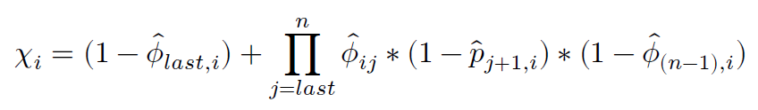
Maximum log-likelihood estimation (MLE)
Chance carcass ‘dies’ immediately after last observation
Product of all probabilities carcass survived but wasn’t seen for each observation point between last capture and n-1

Slide 19

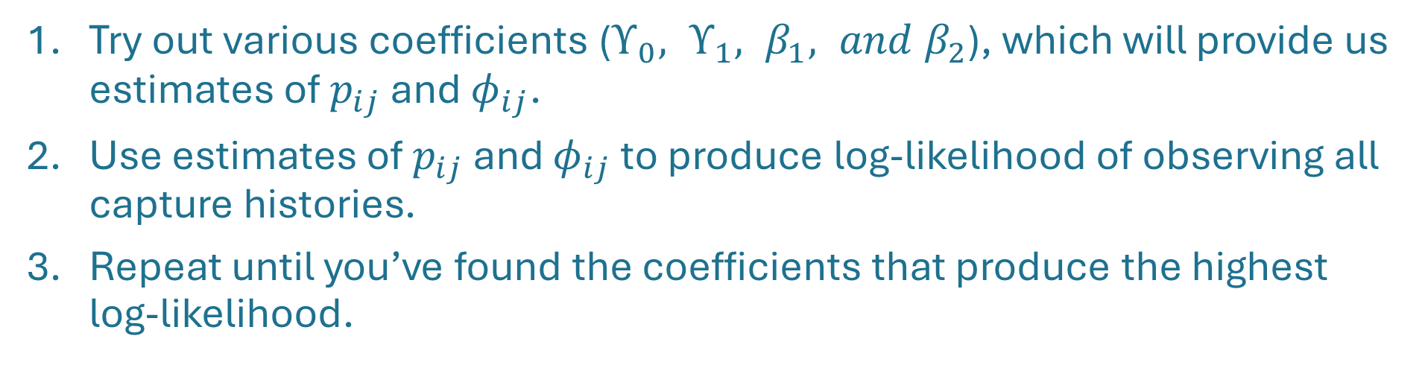
Maximum log-likelihood estimation (MLE)
$${\hat{Φ}}_{ji},{\hat{p}}_{ji}$$
Try out various coefficients ($ϒ_{0}, ϒ_{1}, β_{1}, and β_{2}$), which will provide us estimates of $p_{ij}$ and ${\text{φ}}_{ij}$.
Use estimates of $p_{ij}$ and ${\text{φ}}_{ij}$ to produce log-likelihood of observing all capture histories.
Repeat until you’ve found the coefficients that produce the highest log-likelihood.

Slide 20
Maximum log-likelihood estimation (MLE)
For a simple overview of MLE: https://www.youtube.com/watch?app=desktop&v=XepXtl9YKwc
Of course, our datasets are large, and with multiple covariates, the MLE process is made too complicated to do by hand.
In brief: MLE allows us to get “best guess” answers for problems with no analytical solution.
Fortunately, we can use optimization algorithms to do the work for us.

Slide 21
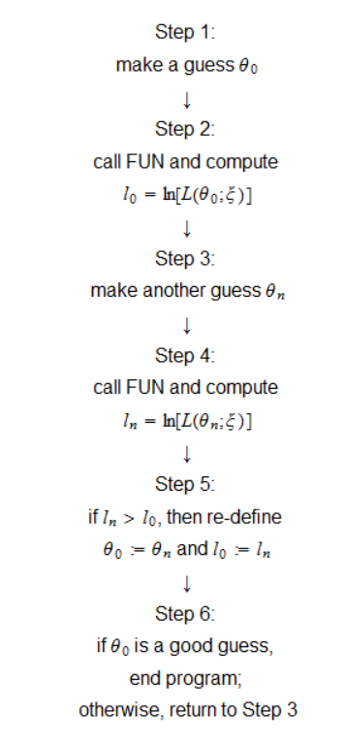
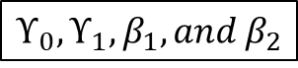
Maximum log-likelihood estimation (MLE)
Optimization Algorithms: https://www.statlect.com/fundamentals-of-statistics/maximum-likelihood-algorithm
$$ϒ_{0}, ϒ_{1}, β_{1}, and β_{2}$$
Covariates
Capture histories
Optimization algorithm

Slide 22
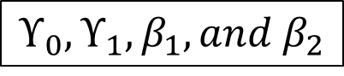
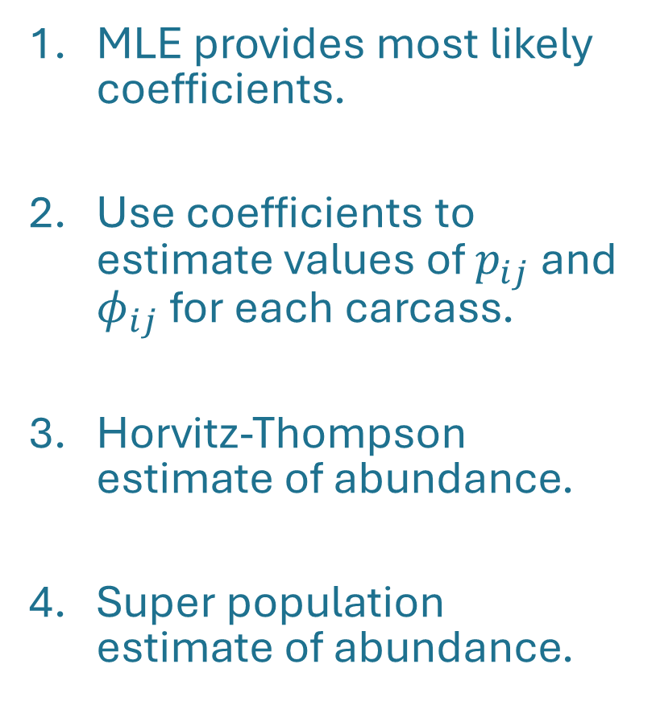

Wrapping up
MLE provides most likely coefficients.
Use coefficients to estimate values of $p_{ij}$ and ${\text{φ}}_{ij}$ for each carcass.
Horvitz-Thompson estimate of abundance.
Super population estimate of abundance.
$$ϒ_{0}, ϒ_{1}, β_{1}, and β_{2}$$
$${\hat{Φ}}_{ji},{\hat{p}}_{ji}$$

Slide 23
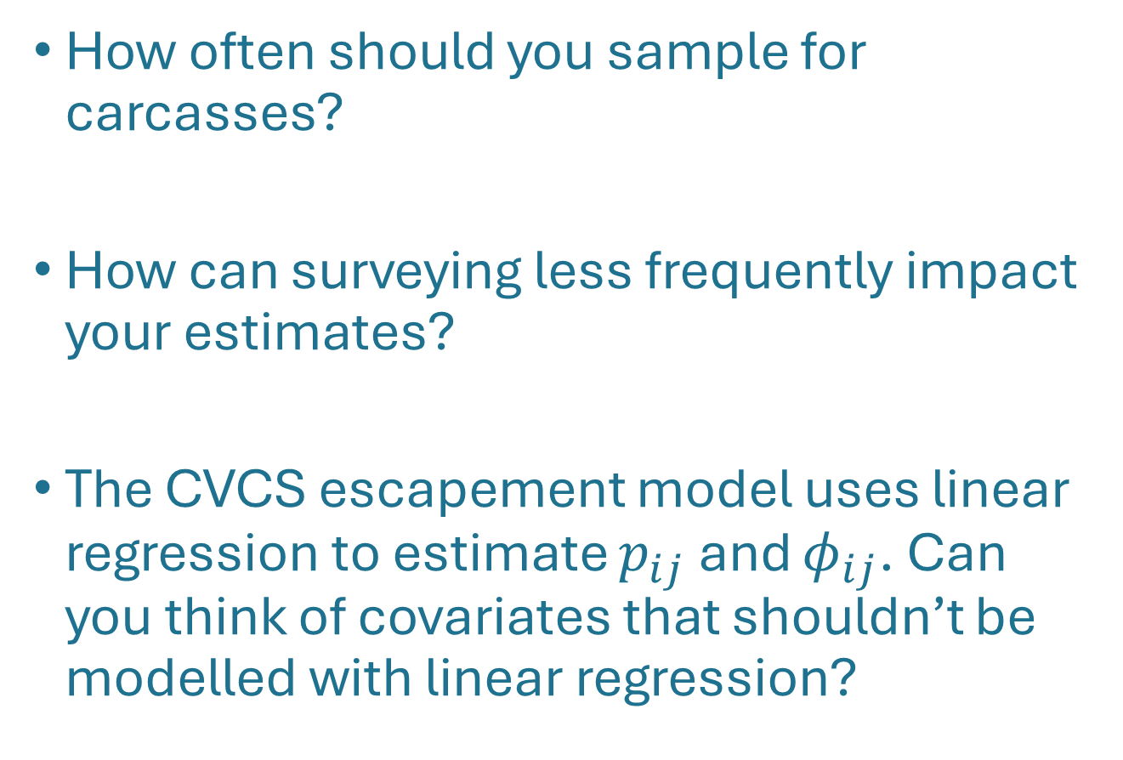
Consider the following:
How often should you sample for carcasses?
How can surveying less frequently impact your estimates?
The CVCS escapement model uses linear regression to estimate $p_{ij}$ and ${\text{φ}}_{ij}$. Can you think of covariates that shouldn’t be modelled with linear regression?

